Slide 4
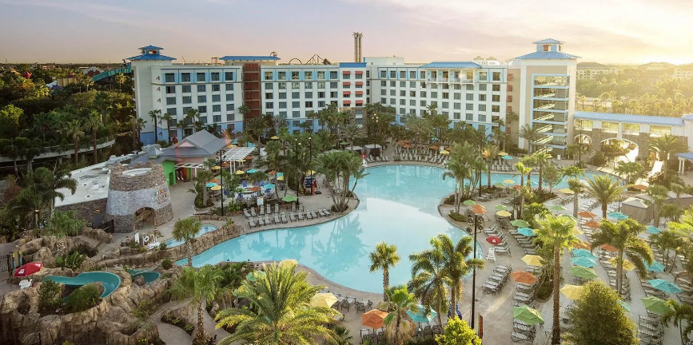
SVIN 2025 Annual Meeting
November 20-22, 2025
Loews Sapphire Falls at Universal Orlando, Florida
@svinsociety @SVINJournal

